Slide 1
EarlyRiders
Toy Horse
MSMA Team 8
Hector Abreu Geng Luo Hairong Wang Ying Wang Yunjiao Liu

Slide 2

Agenda
Executive Summary
Key Insights
Benefit Segments & Ideal Products
Profit Analysis: Current Market
Profit Analysis: Simulated Product Lines

Slide 3
Executive Summary
Key Insights:
Segment consumers into three groups, Younger Children, Older Boys, and Girls
Robust segmentation forces competitor to lower prices regardless of product line scenario
Neglect Amazon Marketplace, sales occur in retail channel, products requires physical senses for accurate valuation of quality
Recommendation:
Provide product line of 3 products
Retailer hesitation, shrink to 2 products
Long term product offering only has two scenarios regardless of initial product line
Simple to implement

Slide 4
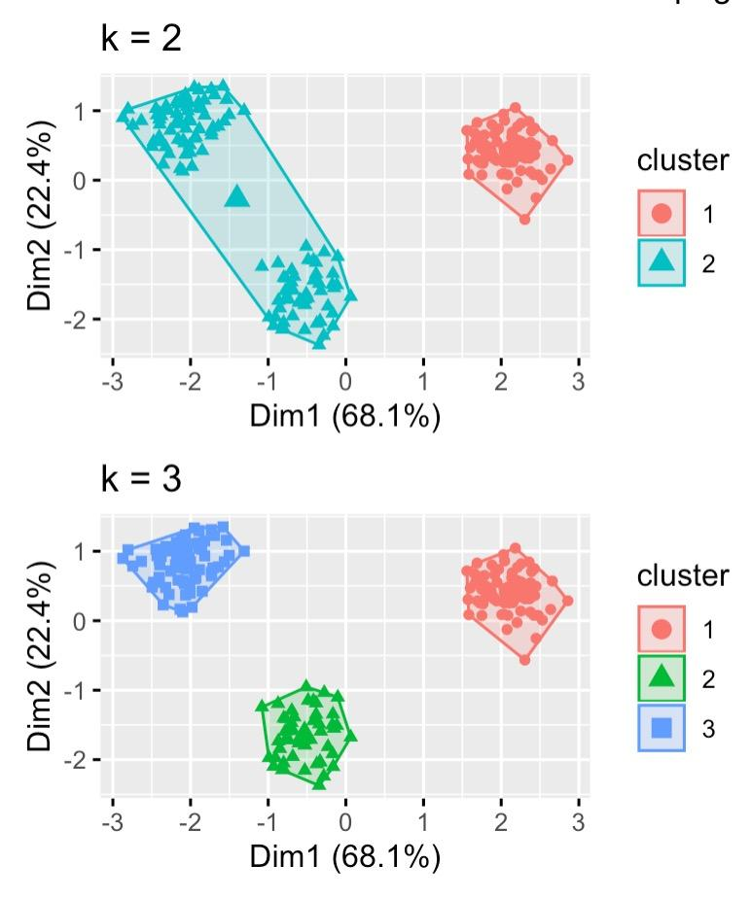
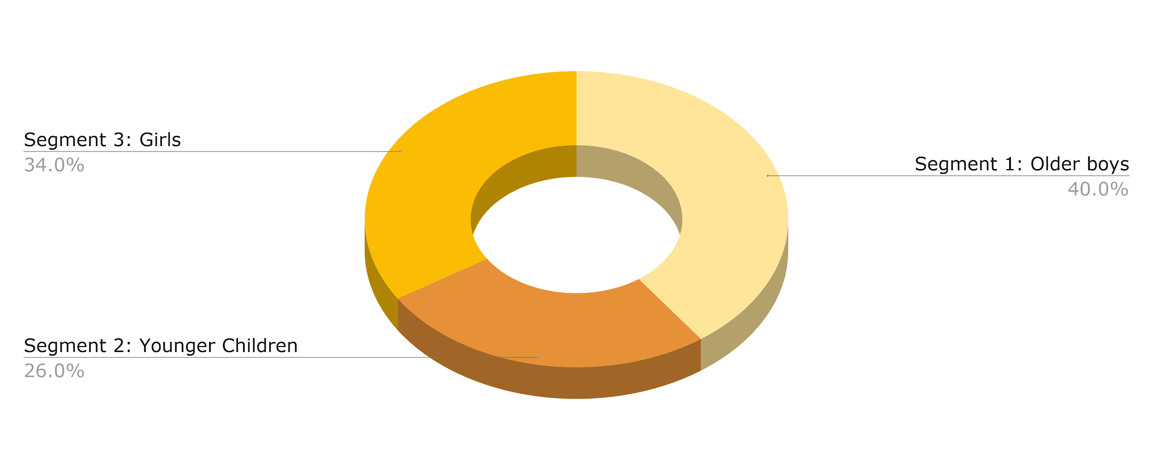
Benefit Segmentation: why 3 not 2?
Notes:
-----
Can use either cluster of 2 groups or cluster of 3 groups.
It would be ideal to choose the clustering scheme that maximizes the differences of the cluster but also minimizes the differences of the individuals within a particular cluster.
For that reason, it is not ideal to use a clustering of 2 groups, as we observe that one of the clusters appears to have 2 sub segments. With 3 clusters, one can target the preferences of each cluster, thus more accurately targeting the preferences of each #individual within the cluster.
Moreover, observing the Total Within Sum of Squares and Average Silhouette Width, it is statistically sound to propose a clustering scheme with 3 groups.

Slide 5
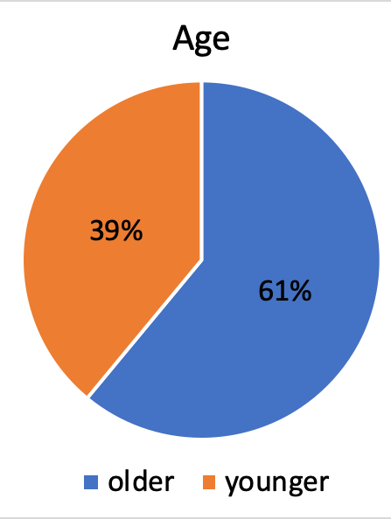
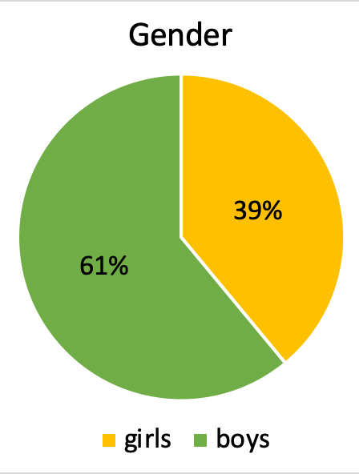
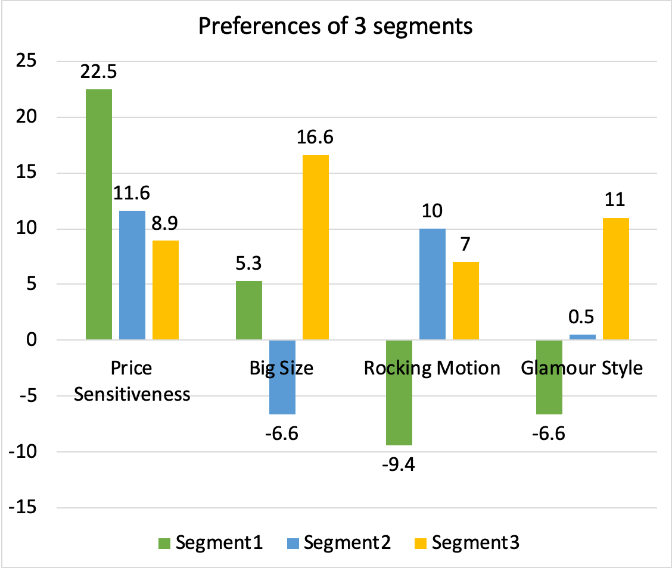
Benefit Segment 1: Older boys
18’’ Bouncing Racing(Low price)
26’’ Bouncing Racing(Low price)
Notes:
------
Cluster 1:
Named this segment older boys for a couple of reasons.
1. 61% of respondents in this segments were 3-4 years
2. 61% of respondents in this segments are males
Following the clustering model that separates them by preferences
1.This segment has the highest positive impact by bouncing motion
2.Only segment to have overwhelming preference for racing style
3.Price Sensitive Segment
4. Size is negligible, will try both in simulation
Given these two findings, we imagine older boys to be the target of this segment as you expect older kids to prefer a bouncing horse than a rocking horse. Moreover, it can be justified that older boys will have a larger preference for style (want a racing horse and definitely not a glamour horse because it is “girly”). Leading us to believe that this segment is older boys and that their targeted products are as follow.
1.18” Bouncing Racing (Low Price)
2.26” Bouncing Racing (Low Price)

Slide 6
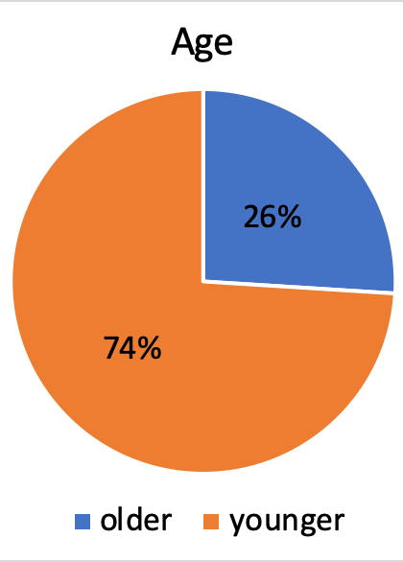
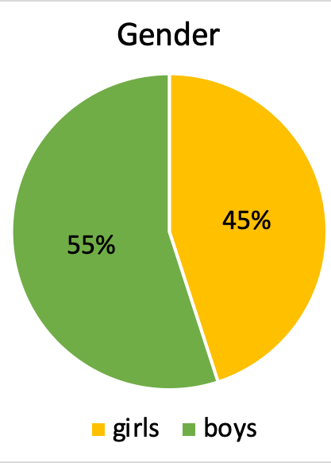
Benefit Segment 2: Younger Children
18” Rocking Racing (Low Price)
18” Rocking Glamour (Low Price)
Notes:
------
Cluster 2:
Named this segment younger children for a couple of reasons.
1. 74% of respondents in this segments were 2 years old
2. Gender is more or less balanced
Following the clustering model that separates them by preferences
1.No preference for style
2.Only segment to have overwhelming preference for small size
3.Price Sensitive Segment
Given the age distribution and preferences, we believe that this segment may be catered towards younger children. It is reasonable to assume that parents will prefer to have their younger child on a small horse, rather than a bigger one. We also believe that this reasoning may lead to a rocking horse and not a bouncing horse for safety measures. When looking at style, it may be the case that the balance between genders in the cluster results into no specific preference. Or it may be the case that parents may not care for style for younger children. For that reason we will have to targeted products in mind for the simulation.
1.18” Rocking Racing (Low Price)
2.18” Rocking Glamour (Low Price)

Slide 7
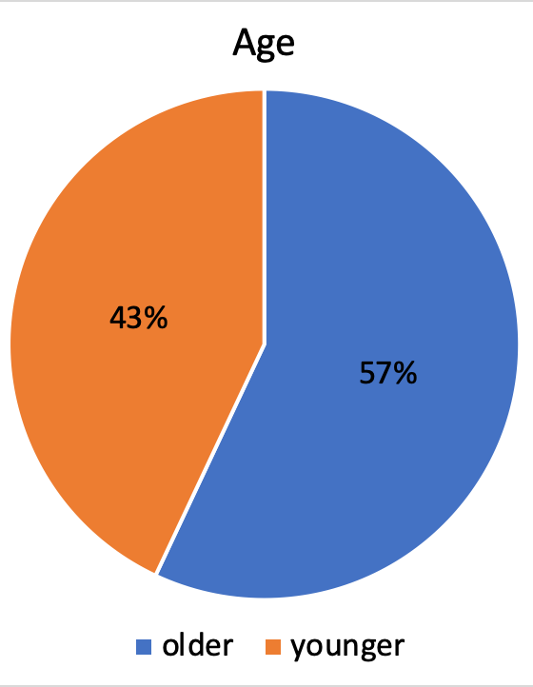
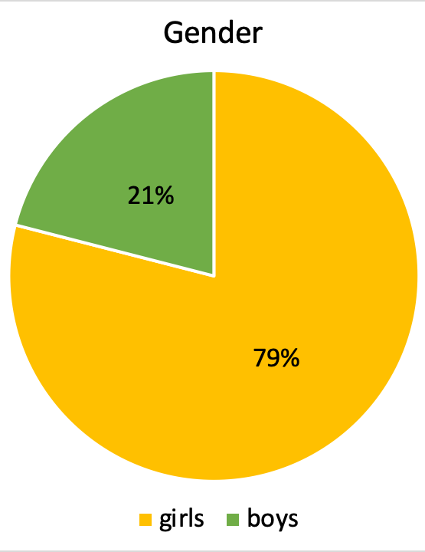
Benefit Segment 3: Girls
26” Rocking Glamour (Low Price)
26” Bouncing Glamour (Low Price)
Notes:
-----
Cluster 3:
Named this segment Girls for a couple of reasons.
1. 79% of respondents in this segments were females
2. Age tends to lean towards older kids, but nonetheless, younger kids are there.
Following the clustering model that separates them by preferences
1.Overwhelming Preference for Glamour Style
2.Strong Preference for Big horses
3.Price Sensitive Segment, but less sensitive than the rest. Opportunity for higher prices?
4.No real preference for motion, will try both
Given the gender distribution and preferences, we believe that this segment may be catered towards Girls. The overwhelming preference for glamour may be caused by the fact that this cluster is 79% female.
1.26” Rocking Glamour (Low Price)
2.26” Bouncing Glamour (Low Price)

Slide 8
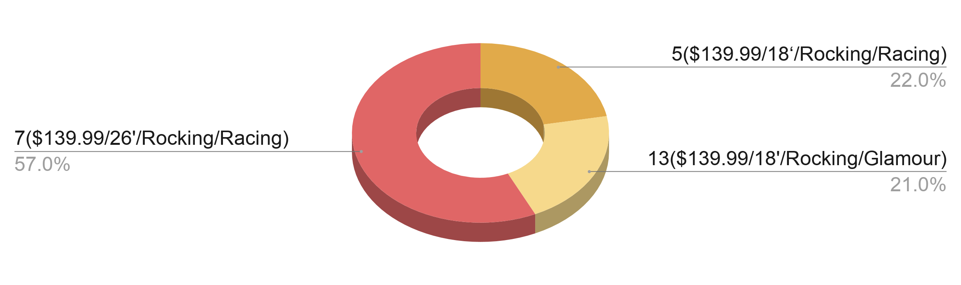
Market Simulation (Current Market)
Here you have a list of items
And some text
But remember not to overload your slides with content
Your audience will listen to you or read the content, but won’t do both.
Competitor’s current market share: 57%
Our current market share:
43%
Profit prediction over a 5 year period:
$415k
Notes:
------
Assessing the current market will allow us to create a basis for comparison. We will be able to measure the improvement on profit that our recommended product lines may have. In the current market, we offer 18” Rocking Racing(High Price) 18” Rocking Glamour(High Price) while the competitor supplies 26” Rocking Racing (High Price). If this were to remain constant for the next 5 years, we can expect profits of about $415K.
Let us show you how implementing a robust consumer segmentation strategy can increase profit(NPV) by at least 66% over a 5 year period. Possibly as high as 76%.

Slide 9
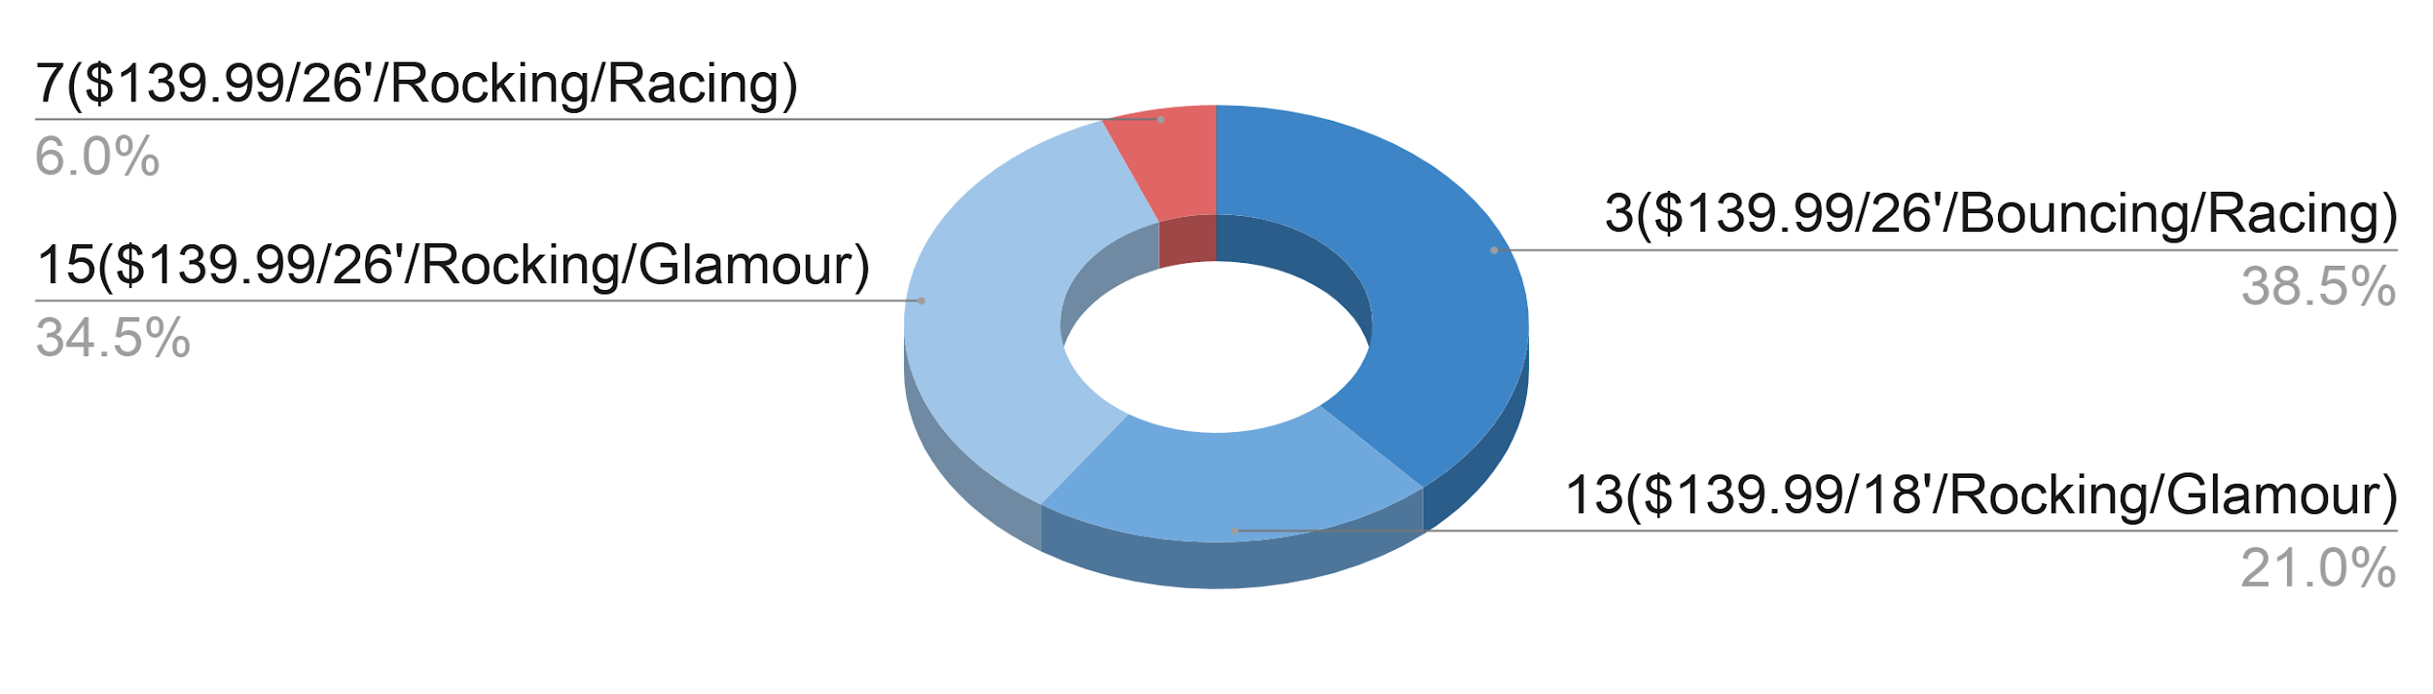
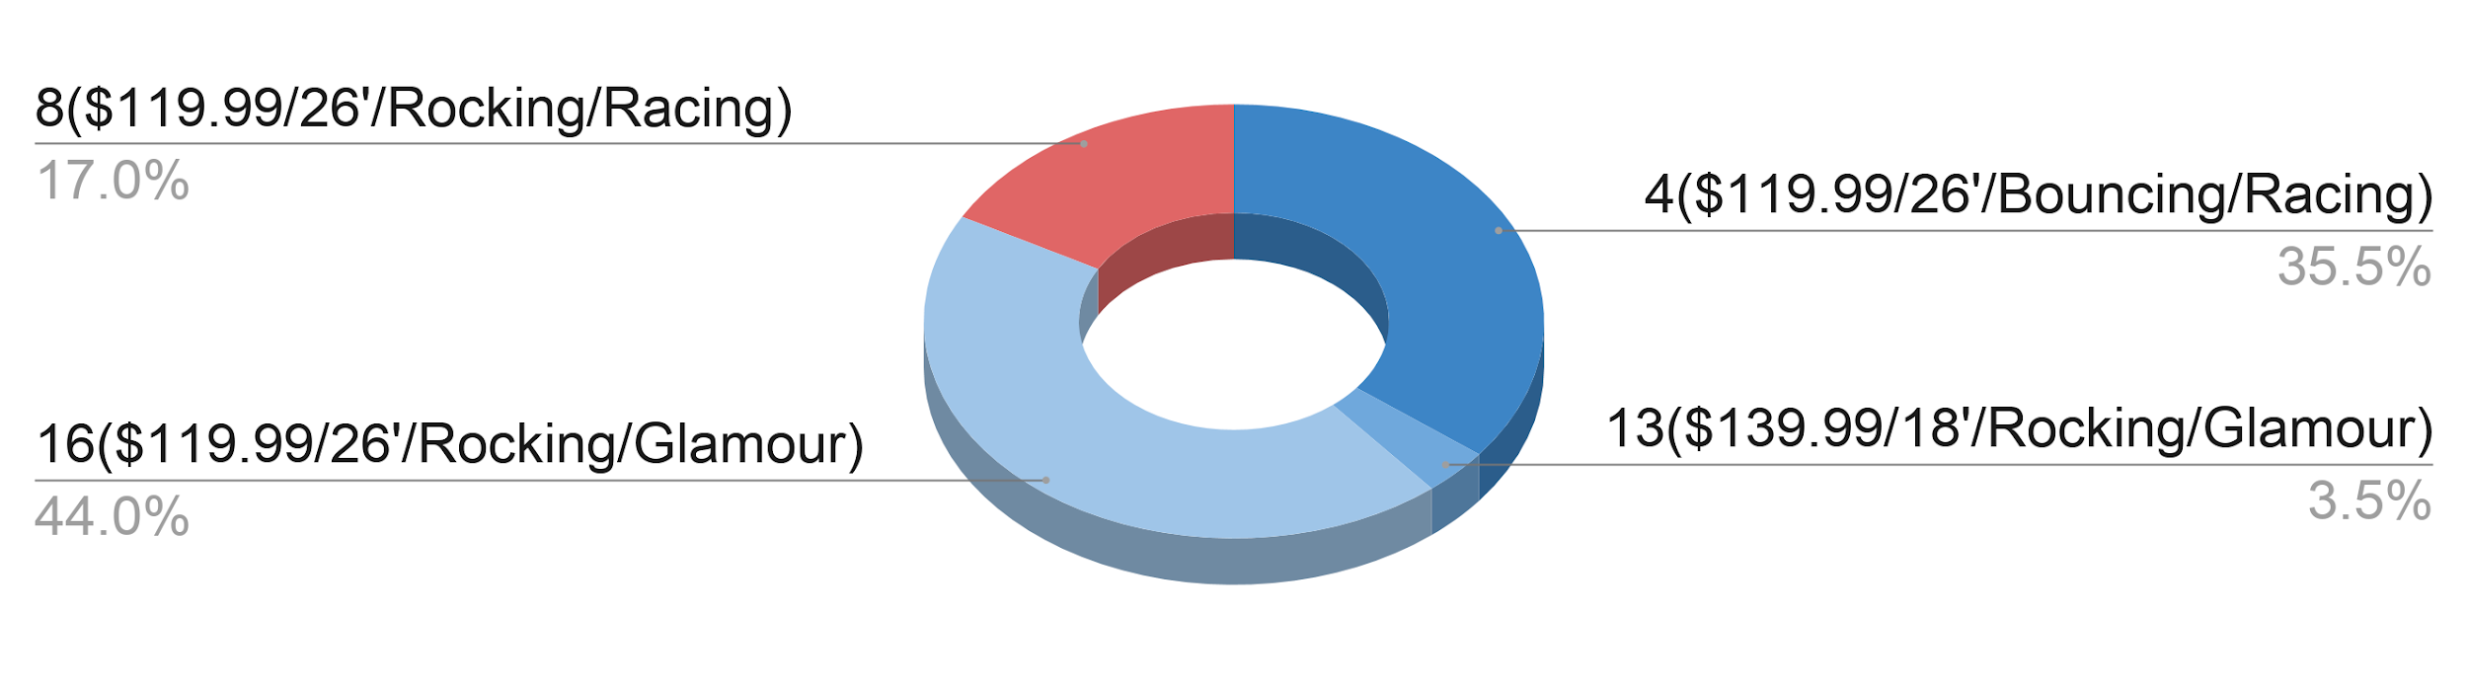
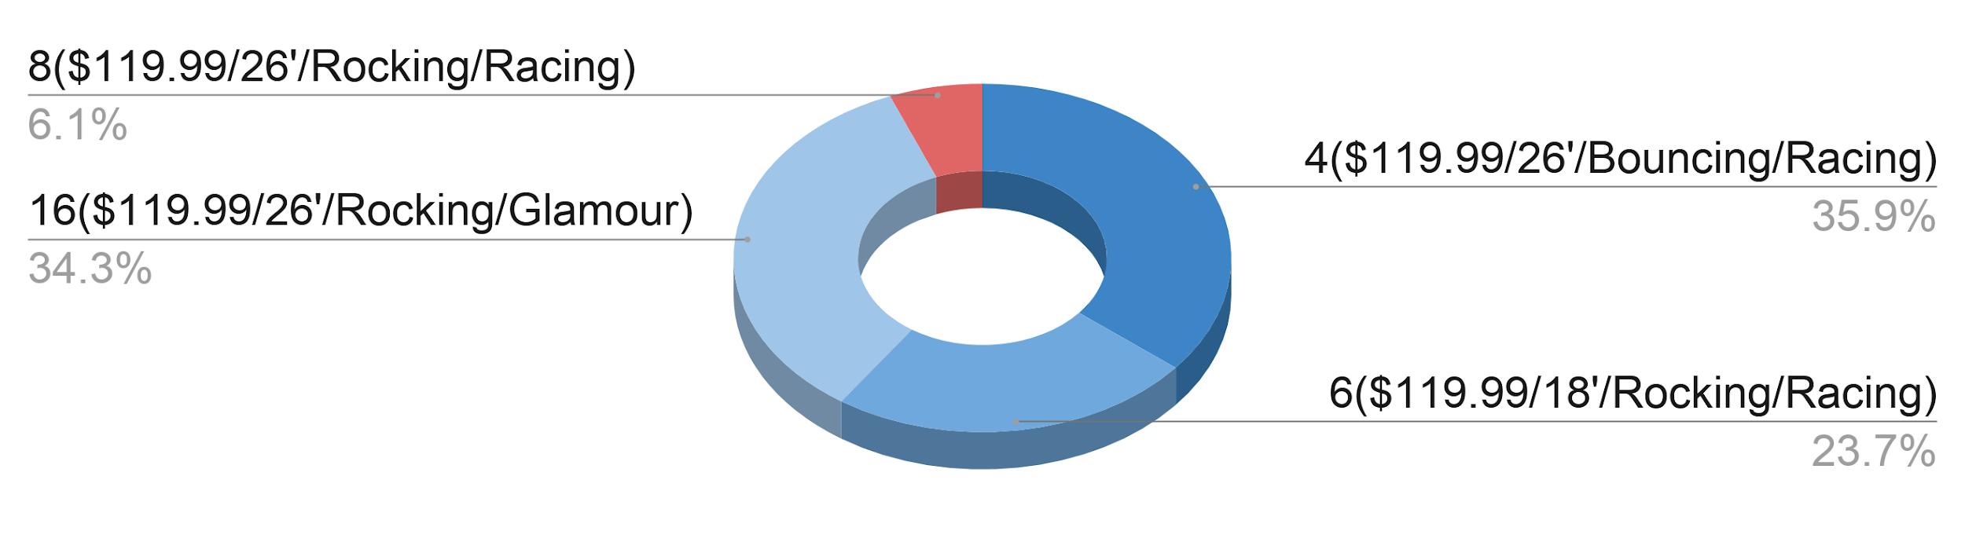
Market Simulation (PL 3 to PL3)
Switching to product lines of 3
All prices at $139.99 at first, lower depending on competitor response
Change product line in the year after
Expected Profits:
Increase by 75%
$313K
Notes:
------
This is the optimal choice for the company. For this strategy we will launch 26” Bouncing Racing (High Price) ,18” Rocking Glamour (High Price) , 26” Rocking Glamour(High Price), while the competitor launches 26” Rocking Racing (High Price). The competitor will switch to 26” Rocking Racing (Low Price), per the market simulation, and we will lower prices for 3 and 15. Resulting in a product line of 26” Bouncing Racing (Low Price),18” Rocking Glamour (High Price) ,26” Rocking Glamour(Low Price) (at no additional cost) while the competitor is supplying 26” Rocking Racing (Low Price). With this product line, we expect to increase profit by 75% on a 5 year period. In terms of dollars, an increase of about $313K.
Recognize that the retailer only carries 2 to 3 products so we must convince them that our 3 products will be more beneficial for them to carry (carry an additional product of ours or drop the competitors product). May be the case that the retailer may choose to remain at two products and willing to consider the third product depending on how we perform in the first year. If that's the case, then you have product line 2

Slide 10
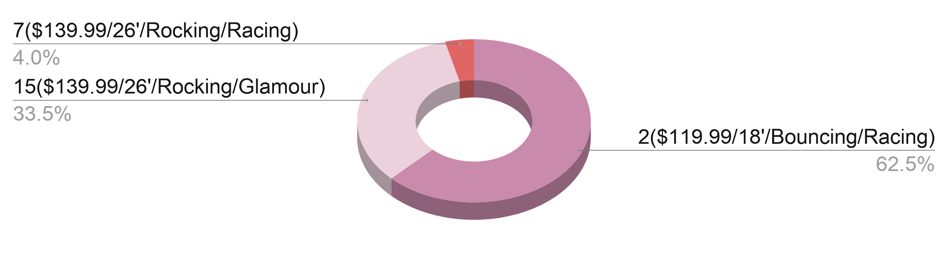
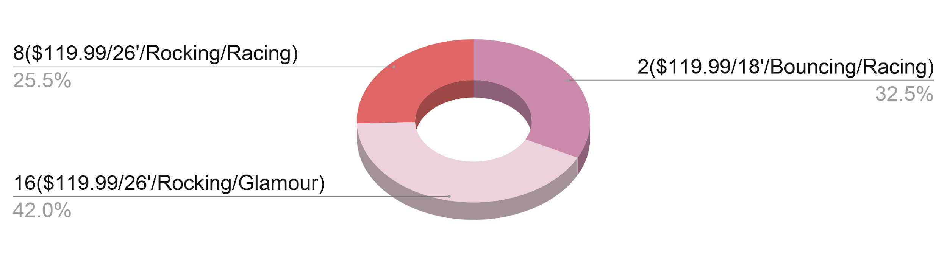
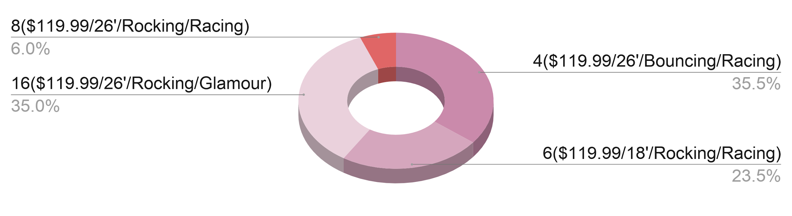
Market Simulation (PL 2 to PL 3)
Switch to 2 new products
Competitor lowers its price in response
Add 1 more product in the second year to win more market share
Expected profit
Increase by 72%
$299K
Notes:
-----
Second most profitable product line option. If the retailer was hesitant about holding 3 of our products then we will recommend these two. Given the performance of this product and willingness to carry a third, we suggest increasing the product line to 3 in the second year and staying consistent with this choice for the rest of the cycle.That is begin by offering a product line of 18” Bouncing Racing(Low Price) and 26” Rocking Glamour(High Price) while the competitor provides 26” Rocking Racing(High Price). Per market share,we expect for the competitor to lower its prices, resulting in product 26” Rocking Racing(Low Price). That will lead us to keep 18” Bouncing Racing(Low Price) and adjust to 26” Rocking Glamour(Low Price) .In the subsequent period, we will replace 18” Bouncing Racing(Low Price) with 26” Bouncing Racing(Low Price), while adding 18” Rocking Racing(Low Price) and retaining 26” Rocking Glamour(Low Price). The competitor will supply 26” Rocking Racing(Low Price).With this dynamic product line we expect to increase profits over the 5 year cycle by 72%. In dollar terms, we expect $299K in profit per year.
This scenario assumes that the retailer will be happy with the performance of our products, therefore, they will be very willing to expand to 3 products. What if it is the case that the retailer shows interest in 3 products early on but then decides to reverse that decision and only allow two? The next scenario will solve that issue…

Slide 11
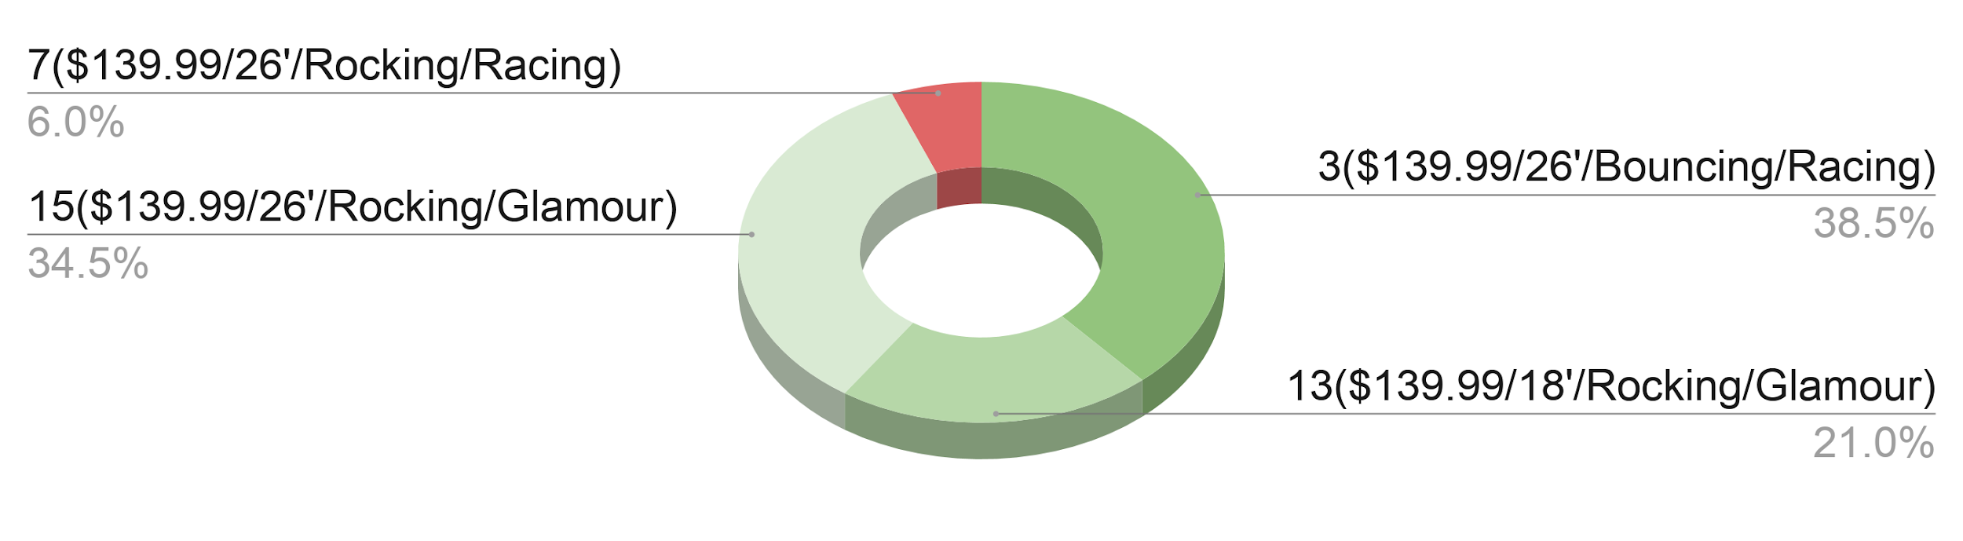
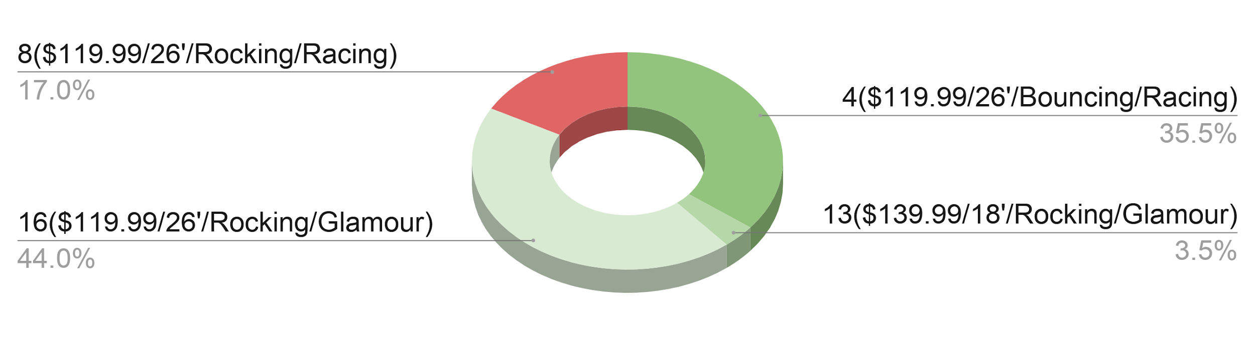
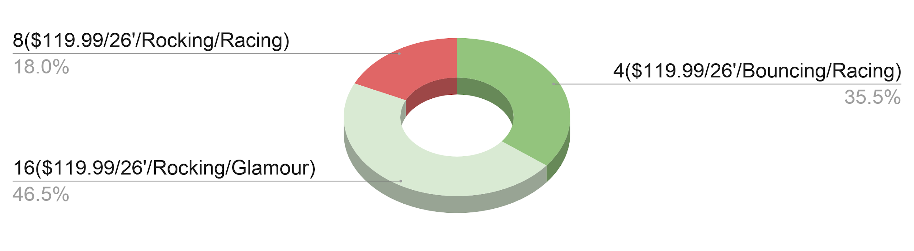
Market Simulation (PL 3 to PL 2)
Add 2 new products and drop 1 product
Drop 1 product in the second year to reduce the cost but maintain the same market share
Expected Profits:
Increase by 70%
$289K
Notes:
----
Third most profitable scenario. If for any given circumstances, the retailer decides to only hold two of our products, we will suggest following this scheme. Given that they permitted a product line of 3, the initial line consists of 26” Bouncing Racing(High Price),18” Rocking Glamour(High Price),26” Rocking Glamour(High Price) while the competitor supplies 26” Rocking Racing(High Price). Per market share,we expect the competitor to lower price and provide 8. Resulting in our product line to change into 26” Bouncing Racing(Low Price) , 18” Rocking Glamour(High Price), 26” Rocking Glamour (Low Price). After the first period, where the retailer may change its mind to only allowing 2 of our products, we will supply products 26” Bouncing Racing(Low Price) and 26” Rocking Glamour(Low Price) while the manufacturer supplies 26” Rocking Racing (Low Price). Under this scenario we expect to increase profits by 70% over a 5 year period. In dollar terms, about $289K.

Slide 12
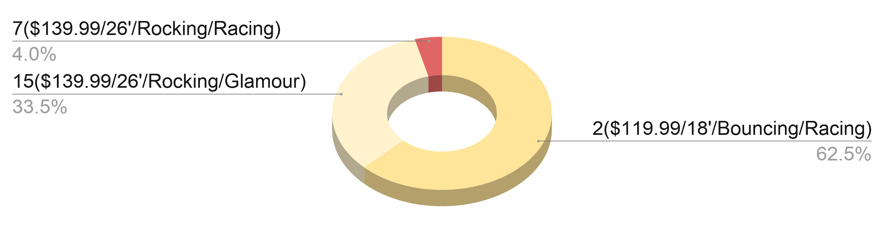
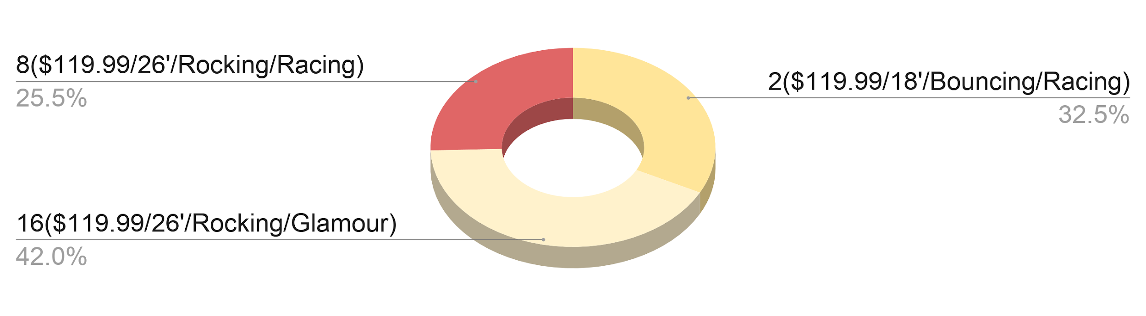
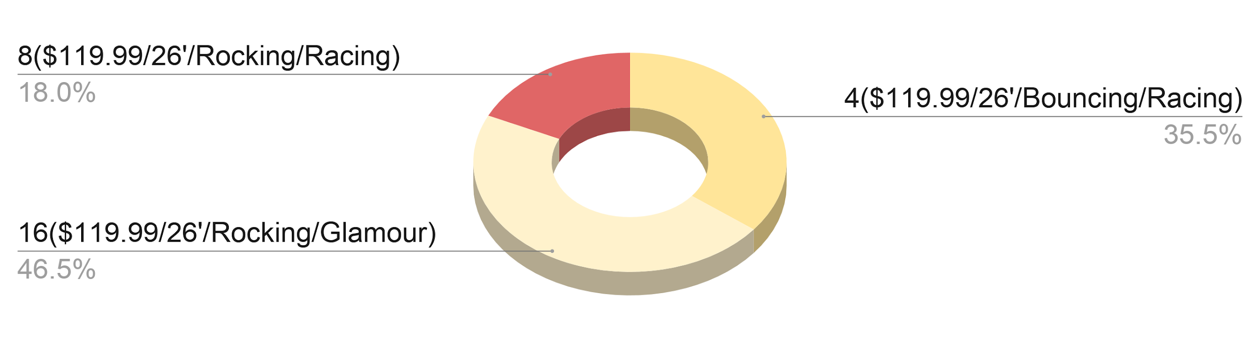
Market Simulation (PL 2 to PL 2)
Switch to 2 new products
Lower our price, switch one product
Keep product lines of 2 to avoid extra cost
Expected Profit:
Increase by 66%
$275K
Notes:
---
Fourth most profitable option. If retailer decides to stay at only two products. We will begin with a product line of 18” Bouncing Racing(Low Price) and 26” Rocking Glamour (High Price) while the competitor has 26” Rocking Racing(High Price). Per market share, we expect the competitor to lower price and offer 26” Rocking Racing(Low Price), to which we will respond by lowering the price of 26” Rocking Glamour (High Price), now offering 26” Rocking Glamour (Low Price). Resulting in a product line of 18” Bouncing Racing(Low Price) ,26” Rocking Glamour (Low Price) while the competitor provides 26” Rocking Racing (Low Price). Under this scenario, we expect profit to increase by 66 percent over a 5 year period. In dollar terms, profit will increase by $275K. In the subsequent period, we expect to swap 18” Bouncing Racing(Low Price) with 26” Bouncing Racing(Low Price) and maintain 26” Rocking Glamour(Low Price) while the competitor maintains 26” Rocking Racing (Low Price).
Recognizing that the competitor may be willing to start with a product line of 3 but may change their mind in a subsequent period, we have prepared a final scenario This option is more profitable than this one, but falls behind the consistent Product Lines of 3 products and the dynamic product line scheme of 2 products to 3(second option).

Slide 13
Recommendation: PL 3 to PL3
Switching to product lines of 3
All prices at $139.99 at first, lower depending on competitor response
Change product line in the year after
Expected Profits:
Increase by 75%
$313K
Notes:
------
This is the optimal choice for the company. For this strategy we will launch 26” Bouncing Racing (High Price) ,18” Rocking Glamour (High Price) , 26” Rocking Glamour(High Price), while the competitor launches 26” Rocking Racing (High Price). The competitor will switch to 26” Rocking Racing (Low Price), per the market simulation, and we will lower prices for 3 and 15. Resulting in a product line of 26” Bouncing Racing (Low Price),18” Rocking Glamour (High Price) ,26” Rocking Glamour(Low Price) (at no additional cost) while the competitor is supplying 26” Rocking Racing (Low Price). With this product line, we expect to increase profit by 75% on a 5 year period. In terms of dollars, an increase of about $313K.
Recognize that the retailer only carries 2 to 3 products so we must convince them that our 3 products will be more beneficial for them to carry (carry an additional product of ours or drop the competitors product). May be the case that the retailer may choose to remain at two products and willing to consider the third product depending on how we perform in the first year. If that's the case, then you have product line 2

Slide 14
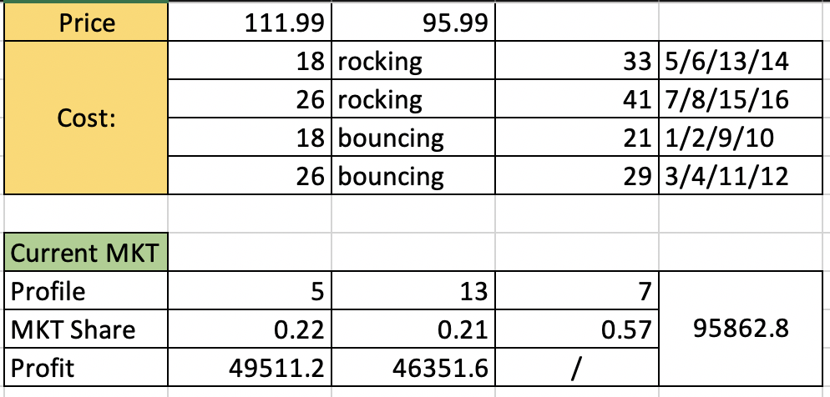
Appendix
Profit calculation for current market in Excel

Slide 15
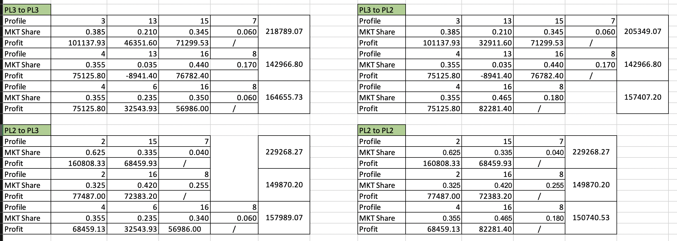
Appendix
Profit calculation based on market share simulation in Excel

Slide 16
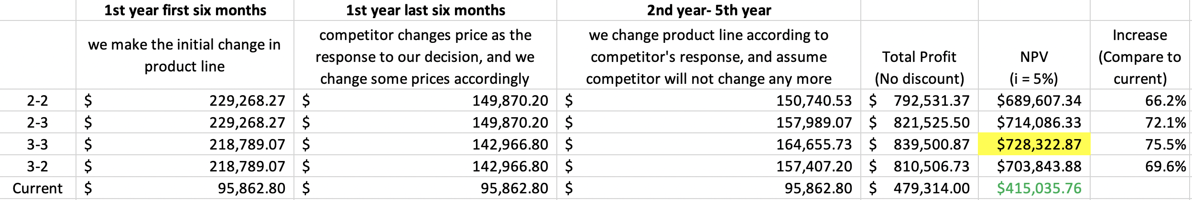
Appendix
Profit calculation based on market share simulation in Excel

